Slide 1

Final Year Project
NATIONAL INSTITUTE OF TECHNOLOGY WARANGAL
CRG:
Condition Rank Generator for Program Repair
Submitted By :
Neeraj Kumar Gond [177141]
Jaswant Meghwal [177124]
Nikhil Kumar [177142]
Under the Guidance of
Dr. Sangharatna Godboley
Assistant Professor, NITW

Slide 2
What we did till now:
We formulated and Implemented the Line/Statement Rank Generator for Program Repair.
We implemented the following:
Line/Statement Code Coverage and Rank Generator.
Suspicious Scores/ Likelihood scores of statements in the code.
Set of indices of suspicious statements (ordered by likelihood score).

Slide 3
The Fault Localization
In general, FAULT LOCALIZATION is the act of tracing and locating of bugs, if any, present in the software. Here we intend to locate bugs in the codes based on some fixed criteria.
Importance of Fault Localization
Software fault localization is one of the most expensive, tedious and time consuming activities.
High demand for Automatic Fault Localization techniques.
Guide programmers to the locations of faults, with minimal human intervention.
This demand has led to the proposal and development of various methods.

Slide 4
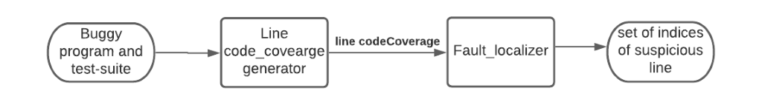
High-Level Component Diagram of FL based on Statement/Line coverage

Slide 5
Implemented Functionalities
Code Coverage
Programming language : Python
Inputs : Program File , corresponding test-suites
Steps :
For each testcase of test-suite, buggy program gets executed.
Store the outputs in a file.
Each output compared with Target-output already there test-suite
Based on match or mismatch passing or failing is declared.
We used dictionary data structure to store {testcase, result} as key-value pair.
Method used for Code Coverage :
[ Settrace (stack frame, event, arg) ]
Python’s settrace() used to test which line is hit by a particular test case.
Arguments of settrace(): The Stack Frame, Event, Argument frame
An event simply returns a ‘call’ or ‘line’ string etc.

Slide 6
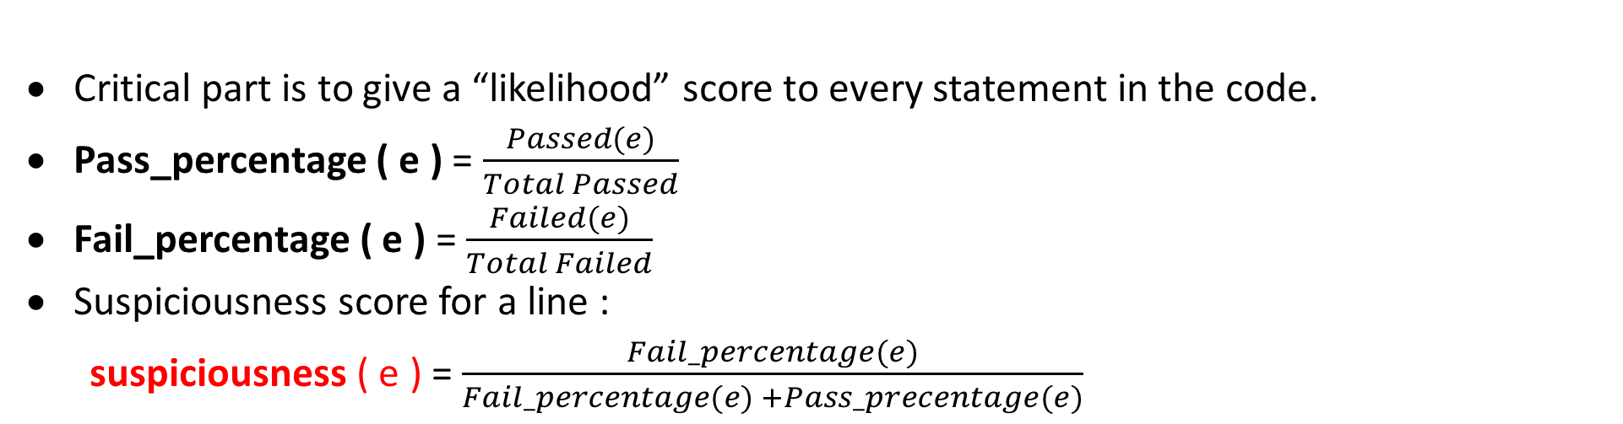
List of Open-source/ Library functionalities used in implementation:
Libraries: python’s csv, fileinput, linecache, os, collections, sys
Functions: sys.settrace(), exec()
Critical part is to give a “likelihood” score to every statement in the code.
Pass_percentage ( e ) = $\frac{Passed(e)}{Total Passed}$
Fail_percentage ( e ) = $\frac{Failed(e)}{Total Failed}$
Suspiciousness score for a line :
suspiciousness ( e ) = $\frac{Fail_percentage(e)}{Fail_percentage(e) +Pass_precentage(e)}$
Suspiciousness value range : 0$≤$ e $≤$ 1
RANK :
Rank of a statement - Statement with highest suspiciousness score gets higher rank.
Suspiciousness score ( e ) for each line is calculated and sorted in descending order.
Line of code with the higher rank score gets priority for evaluation.

Slide 7
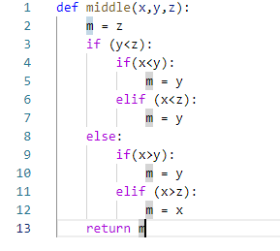
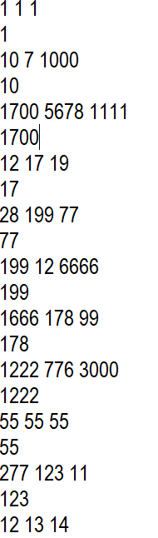
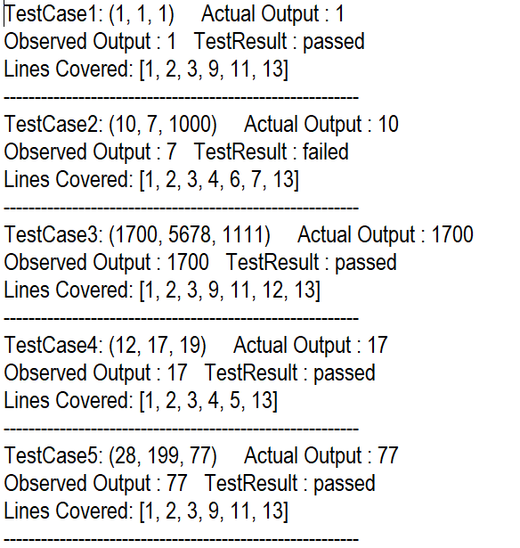
An Example:
Input: Buggy program (middle.py), Test-suite (testSuiteMid.txt)
Note: Bug in line number 7
Intermediate Output: Code-coverage (Output1.txt)

Slide 8
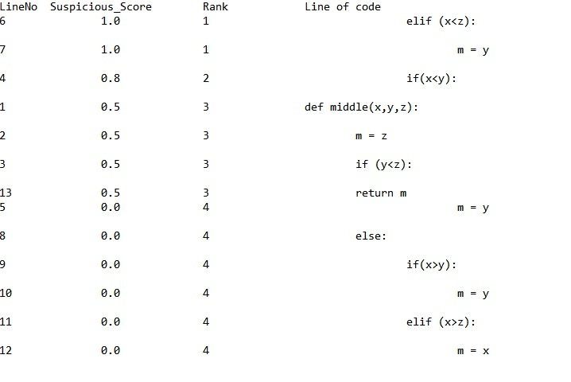
Final Output : Set of lines ranked based on suspicious score

Slide 9
What’s wrong with statement coverage/Line code coverage?
Statement coverage:
Statement coverage is a code coverage metric that tells you whether the flow of control reached every executable statement of source code at least once.
Of all the structural coverage criteria, statement coverage is the weakest, indicating the fewest number of test cases. Bugs can easily occur in the cases that statement coverage cannot see.
In particular, statement coverage does not call for testing the following:
Simple If Statements
Logic Operators(&&, ||, and ?:)
Loop terminations decisions
Do-while loops

Slide 10
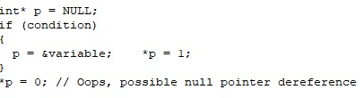
Specific Issues :
Logical Operators
Statement coverage cannot distinguish the code separated by logical operators from the rest of the statement. Executing any part of the code in a statement causes statement coverage to declare the whole statement fully covered.
Statement coverage declares this code fragment fully covered when condition is true. With condition false, the call to strcmp gets an invalid argument, a null pointer.
Simple If-Statements
Statement coverage does not call for testing simple if statements. A simple if statement has no else-clause. No source code exists for the false outcome, so statement coverage cannot measure it.
Without a test case that causes condition to evaluate false, statement coverage declares this code fully covered. In fact, if condition ever evaluates false, this code dereferences a null pointer.

Slide 11
What we expect from our code coverage?
To expose bugs.
Should exercise maximum number of possible paths through the code. The more paths you exercise, the more likely your testing is to expose bugs.
A path is a sequence of branches (decisions), or conditions (logical predicates).
Bugs are often sensitive to branches and conditions. For example, incorrectly writing a condition such as i<=n rather than i<n may cause a boundary error bug.
So we move to an another method of fault localization which is based on condition coverage.

Slide 12
Objective
To identify potentially faulty predicates ranked based on their fitness score using condition coverage.

Slide 13

Condition coverage :
Condition Coverage or expression coverage is a testing method used to test and evaluate the variables or sub-expressions in the conditional statement.
The goal of condition coverage is to check individual outcomes for each logical condition.
Condition coverage offers better sensitivity to the control flow than statement coverage.
In this coverage, expressions with logical operands are only considered.For example, if an expression has Boolean operations like AND, OR, XOR, which indicates total possibilities.
Condition coverage does not give a guarantee about full decision coverage.
The formula to calculate Condition Coverage:

Slide 14
Example:
For the above expression, we have 4 possible combinations
TT
FF
TF
FT
Consider the following input
X=3 Y=4 | (x<y) | TRUE | Condition Coverage is ¼ = 25%
A=3 B=4 | (a>b) | FALSE
(x<y) and (a>b) are atomic conditions

Slide 15
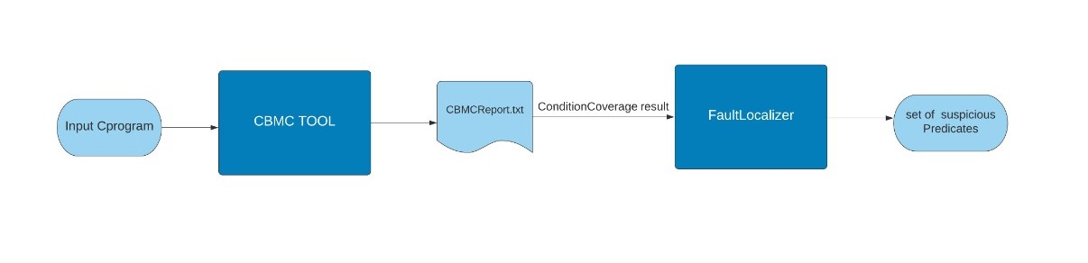
Component diagram of FL based on condition code
coverage :

Slide 16
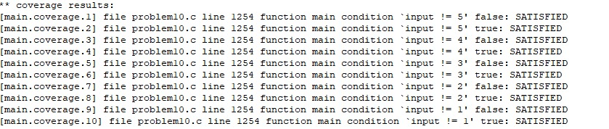
CBMC :
CBMC is a Bounded Model Checker for C and C++ programs.
CBMC verifies memory safety (which includes array out of bounds checks and checks for the safe use of pointers), checks for exceptions, checks for various variants of undefined behaviour, and user-specified assertions.
Here, in our Project we use CBMC to generate the condition coverage of the code.
Results generated by CBMC :

Slide 17
Definitions and implemented functionalities :
Predicate : A path predicate expression is a set of Boolean expressions, all of which must be satisfied to achieve the selected path. Any set of input values that satisfy all of the conditions of the path predicate expression will force the routine to the path.
Atomic Condition : A condition that cannot be decomposed, i.e., a condition that does not contain two or more single conditions joined by a logical operator (AND, OR, XOR).
e.g. :
if(((a1551570219 == 32 && (( cf==1 && a1944816302 == 32) && (input == 2))) && a1041640432 == 10))
In our Code we defined several properties of a predicate object.
Rank
STarget
SObserved
Fitness
AtomCount
OperatorScore
ReachabilityScore
LineNo (line # of predicate p in C program)
Text (content of predicate p)

Slide 18
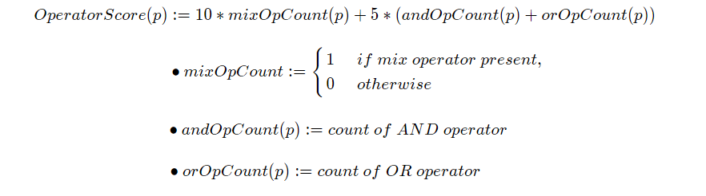
Working Formulae :
Atom count :
e.g. : if(a1551570219 == 32 && ( cf==1 && a1944816302 == 32))
Here atom count is 3.
Operator Score :
e.g. : if(a1551570219 == 32 && ( cf==1 || a1944816302 == 32))
operator score = (10*1) + 5*(1+1)=20

Slide 19
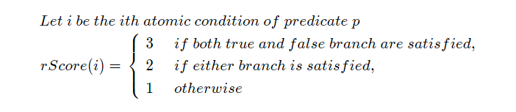
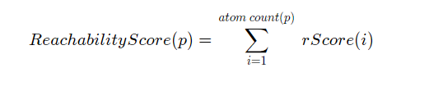
Reachability Score :
e.g. :
[errorCheck.coverage.1] file problem10.c line 205 function errorCheck condition `a1933271548 == 3' false: SATISFIED
[errorCheck.coverage.2] file problem10.c line 205 function errorCheck condition `a1933271548 == 3' true: SATISFIED
[errorCheck.coverage.3] file problem10.c line 205 function errorCheck condition `a1554992028 == 9' false: FAILED
[errorCheck.coverage.4] file problem10.c line 205 function errorCheck condition `a1554992028 == 9' true: SATISFIED
[errorCheck.coverage.5] file problem10.c line 205 function errorCheck condition `a1551570219 == 34' false: FAILED
[errorCheck.coverage.6] file problem10.c line 205 function errorCheck condition `a1551570219 == 34' true: FAILED
rScore(1) = 3 ; rScore(2) = 2 ; rScore(3) = 1
Reachability Score(p) = 3 + 2 + 1 = 6

Slide 20
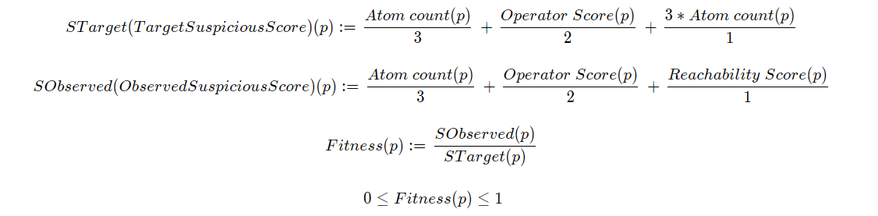
Fitness Score :
e.g. : p => if(a1933271548 == 3 || (a1554992028 == 9 && a1551570219 == 34))
[errorCheck.coverage.1] file problem10.c line 205 function errorCheck condition `a1933271548 == 3' false: SATISFIED
[errorCheck.coverage.2] file problem10.c line 205 function errorCheck condition `a1933271548 == 3' true: SATISFIED
[errorCheck.coverage.3] file problem10.c line 205 function errorCheck condition `a1554992028 == 9' false: FAILED
[errorCheck.coverage.4] file problem10.c line 205 function errorCheck condition `a1554992028 == 9' true: SATISFIED
[errorCheck.coverage.5] file problem10.c line 205 function errorCheck condition `a1551570219 == 34' false: FAILED
[errorCheck.coverage.6] file problem10.c line 205 function errorCheck condition `a1551570219 == 34' true: FAILED
rScore(1) = 3 ; rScore(2) = 2 ; rScore(3) = 1
Reachability Score(p) = 3 + 2 + 1 = 6
Atom count(p) = 3
Operator Score(p) = 20
STarget(p) = 3/3 + 20/2 + (3*3)/1 = 20
SObserved)(p) = 3/3 + 20/2 + 6/1 = 17
Fitness(p) = 0.85

Slide 21
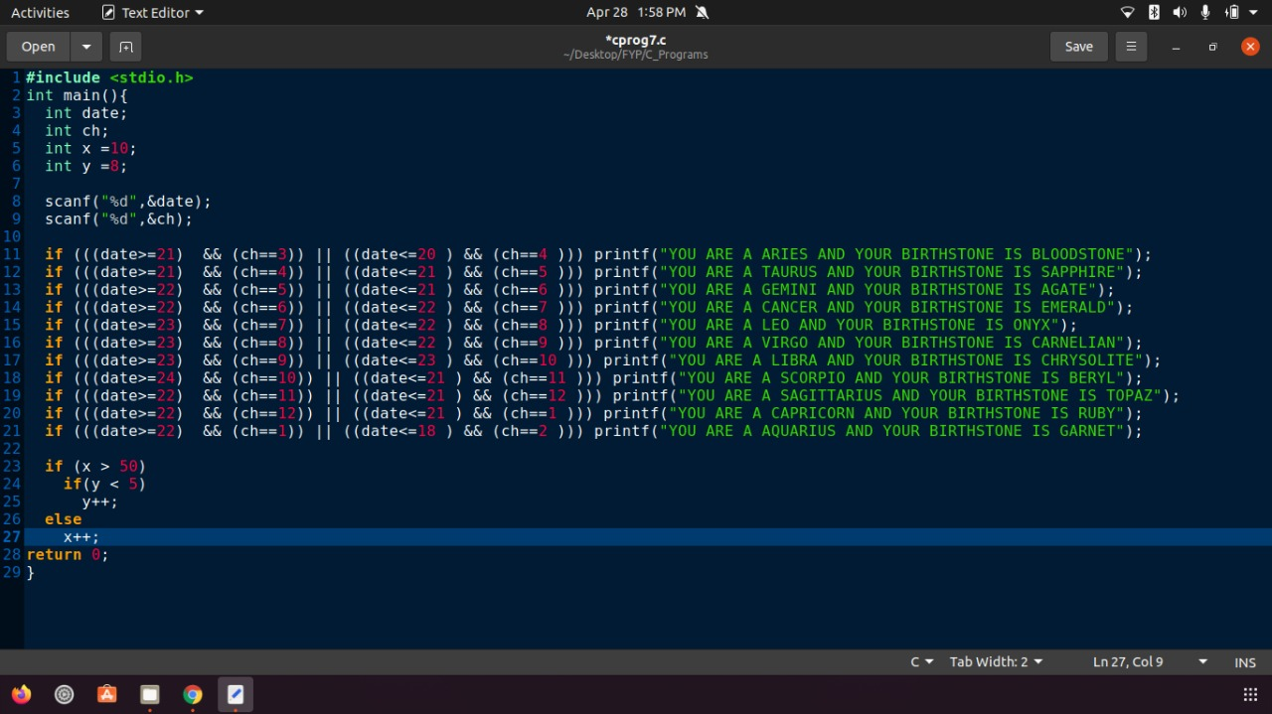
Observations :
Sample Input

Slide 22
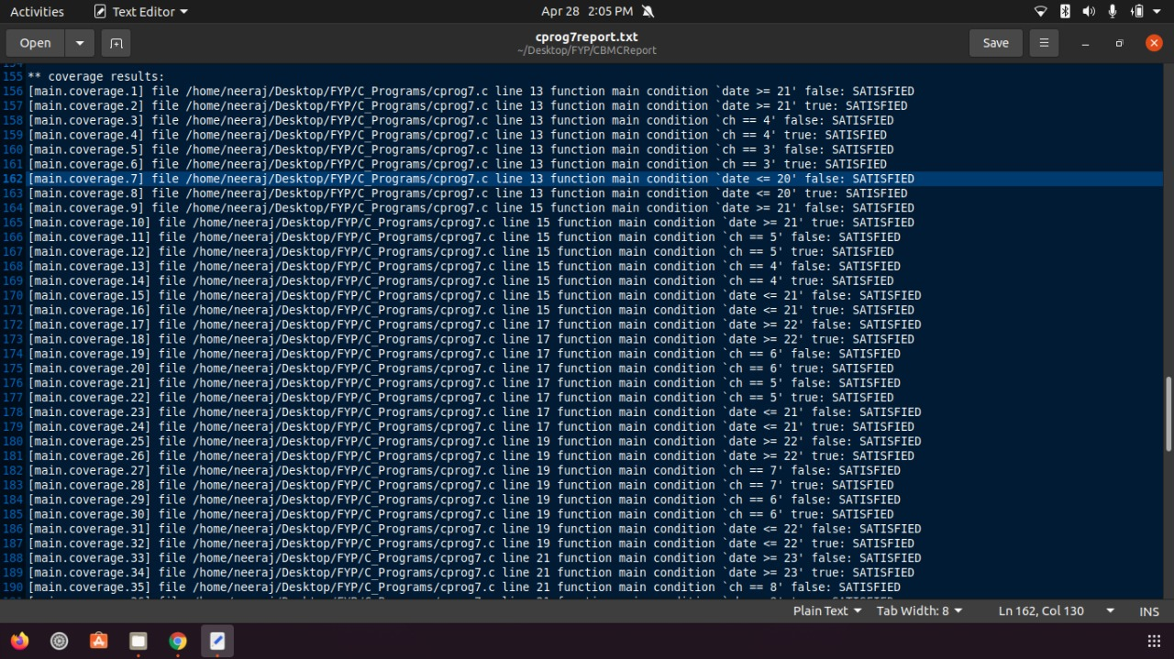
Sample Output :
Condition Code Coverage

Slide 23
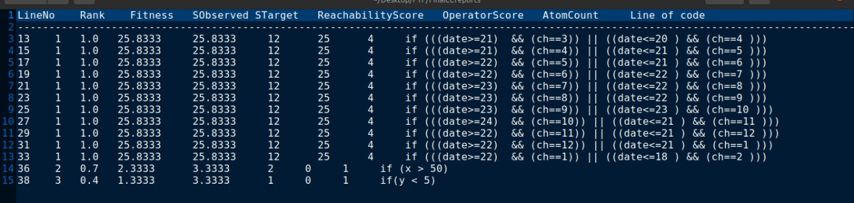
Output

Slide 24
Contributions:
Neeraj Kumar Gond [ 177141 ]
Created test-suite and input files ( buggy programmes ).
Idea and Formulation of fitness score.
Maintenance of Code for Line Code Coverage and Condition Code Coverage based FL.
Prepared the final output for Condition Code Coverage based FL.
Jaswant Meghwal [ 177124 ]
Implemented trace() function.
Formulation of fitness score.
Implemented the Ranking Function of predicate
Prepared the Architecture Diagrams of FL
Nikhil Kumar [ 177142 ]
Created final code-coverage using outputs from trace() function.
Implemented the code for fetching information of CBMC report file.
Contribution in Implementation of suspicious score and ranking for Line Code Coverage.
Formulation of fitness score.

Slide 25
References
[1] Afzal, Afsoon & Motwani, Manish & Stolee, Kathryn & Goues, Claire & Brun, Yuriy. (2019). SOSRepair: Expressive Semantic Search for Real-World Program Repair. IEEE Transactions on Software Engineering. PP. 10.1109/TSE.2019.2944914.
http://spideruci.org/papers/jones05.pdf​
​
[2] Jones, James & Harrold, Mary. (2005). Empirical evaluation of the Tarantula automatic fault-localization technique. 20th IEEE/ACM International Conference on Automated Software Engineering, ASE 2005. 273-282. 10.1145/1101908.1101949​
[3] Abd-El-Malek, Michael, Gregory R. Ganger, Garth R. Goodson, Michael K. Reiter, and Jay J. Wylie. "Fault-scalable Byzantine fault-tolerant services." ACM SIGOPS Operating Systems Review 39, no. 5 (2005): 59-74.
[4] Angell, Rico, Brittany Johnson, Yuriy Brun, and Alexandra Meliou. "Themis: Automatically testing software for discrimination." In Proceedings of the 2018 26th ACM Joint Meeting on European Software Engineering Conference and Symposium on the Foundations of Software Engineering, pp. 871-875. 2018.

Slide 26
References:
[5] Beschastnikh, Ivan, Yuriy Brun, Michael D. Ernst, and Arvind Krishnamurthy. "Inferring models of concurrent systems from logs of their behavior with CSight." In Proceedings of the 36th International Conference on Software Engineering, pp. 468-479. 2014.
​
[6] Carzaniga, Antonio, Alessandra Gorla, Andrea Mattavelli, Nicolo Perino, and Mauro Pezze. "Automatic recovery from runtime failures." In 2013 35th International Conference on Software Engineering (ICSE), pp. 782-791. IEEE, 2013.​
[7] Böhme, Marcel, Ezekiel O. Soremekun, Sudipta Chattopadhyay, Emamurho Ugherughe, and Andreas Zeller. "Where is the bug and how is it fixed? an experiment with practitioners." In Proceedings of the 2017 11th Joint Meeting on Foundations of Software Engineering, pp. 117-128. 2017.
[8] Cadar, Cristian, Daniel Dunbar, and Dawson R. Engler. "Klee: unassisted and automatic generation of high-coverage tests for complex systems programs." In OSDI, vol. 8, pp. 209-224. 2008.
[9] Hua, Jinru, Mengshi Zhang, Kaiyuan Wang, and Sarfraz Khurshid. "Towards practical program repair with on-demand candidate generation." In Proceedings of the 40th international conference on software engineering, pp. 12-23. 2018.

Slide 27
References:
[10] Jha, Susmit, Sumit Gulwani, Sanjit A. Seshia, and Ashish Tiwari. "Oracle-guided component-based program synthesis." In 2010 ACM/IEEE 32nd International Conference on Software Engineering, vol. 1, pp. 215-224. IEEE, 2010.
[11] Jones, James A., Mary Jean Harrold, and John Stasko. "Visualization of test information to assist fault localization." In Proceedings of the 24th International Conference on Software Engineering. ICSE 2002, pp. 467-477. IEEE, 2002.​
[12] Kim, Dongsun, Jaechang Nam, Jaewoo Song, and Sunghun Kim. "Automatic patch generation learned from human-written patches." In 2013 35th International Conference on Software Engineering (ICSE), pp. 802-811. IEEE, 2013.
GitHub Link For the Code

